Slide 1


Insurance Fraud Detection using Active Learning
Presented by:
Dr. Nandan Sudarsanam
Aakash Sarraf
Sujal Burad

Slide 2
Initial Objective + Evolution of Objectives
Core Objectives:
Reduce financial loss in insurance streams for on ground use-cases.
Additional Objectives:
Maximize ROI on labeling, to best spend a budget of new human labels to improve models to check if “what” we label matters equally as “how many”.
To capture data distribution drift by allowing model to "learn as it goes" & refine its uncertainty with every batch.
Accuracy based implementation for analysis.

Slide 3
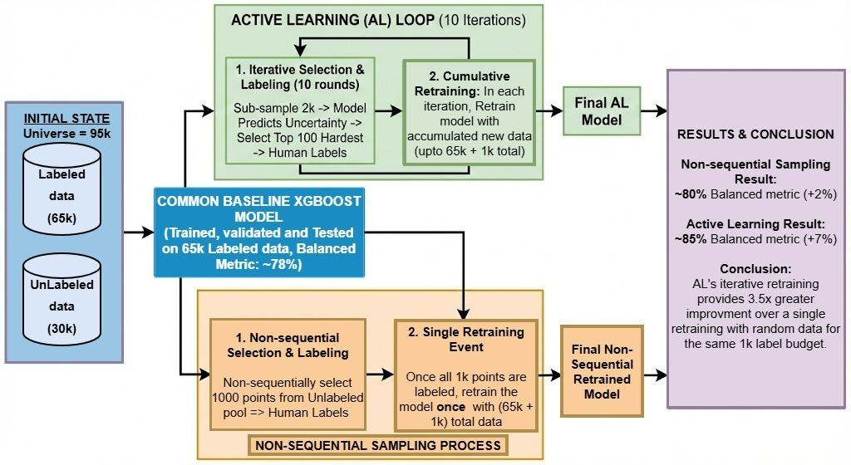
Methodologies + Evolution
Implemented 4 strategies for uncertain points selection and compared their results across accuracy and financial cost based metric.
Formulated a hybrid strategy encompassing their combination.

Slide 4
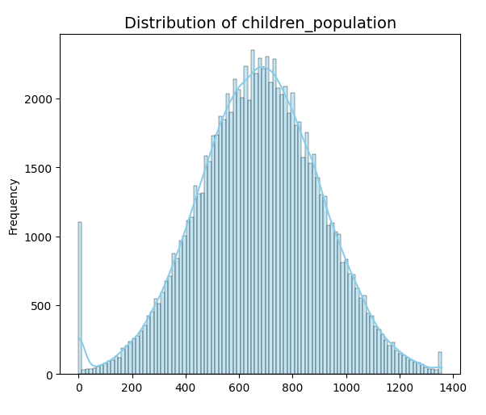
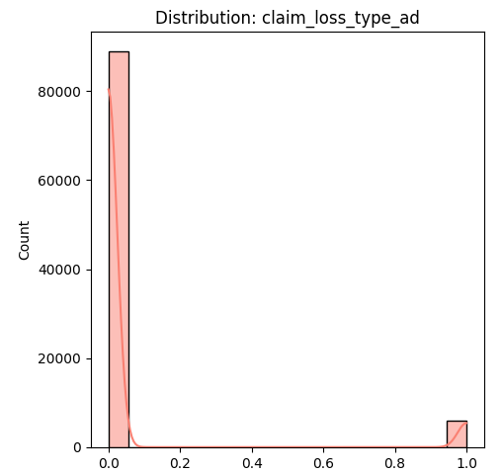
Data Generation
Numerical distribution: Gaussian distribution over the [min, max] range, with random noise addition
Categorical distribution: One-hot labeling.

Slide 5
Weighted cost
COST_TP = 100 ⇔ model says fraud (1), actually fraud (1) ⇒ investigation cost
COST_FP = 150 ⇔ model says fraud (1), actually not fraud (0) ⇒ false alarm cost + reputation damage
COST_TN = 0 ⇔ model says not fraud (0), actually not fraud (0) ⇒ no cost
COST_FN = 0.9 x sum_insured ⇔ model says not fraud (0), actually fraud (1)⇒ missed fraud = pay out 90% of claim
See References B9, B10, B11.

Slide 6
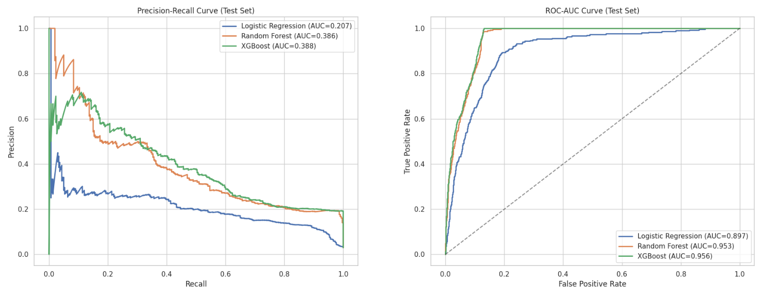
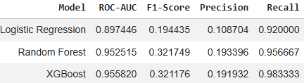
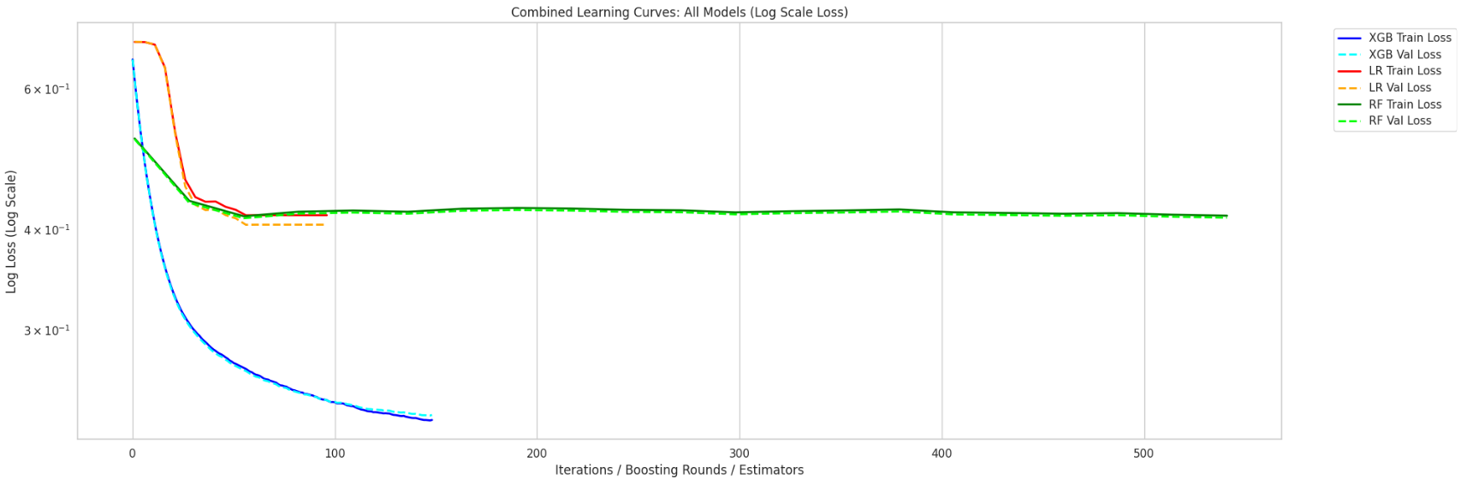
Results - One Shot Training (Accuracy based model)
Train (45k) and val (20k) from labeled, while Test (10k) from unlabeled set

Slide 7
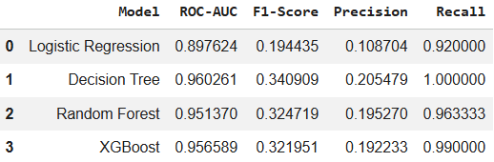
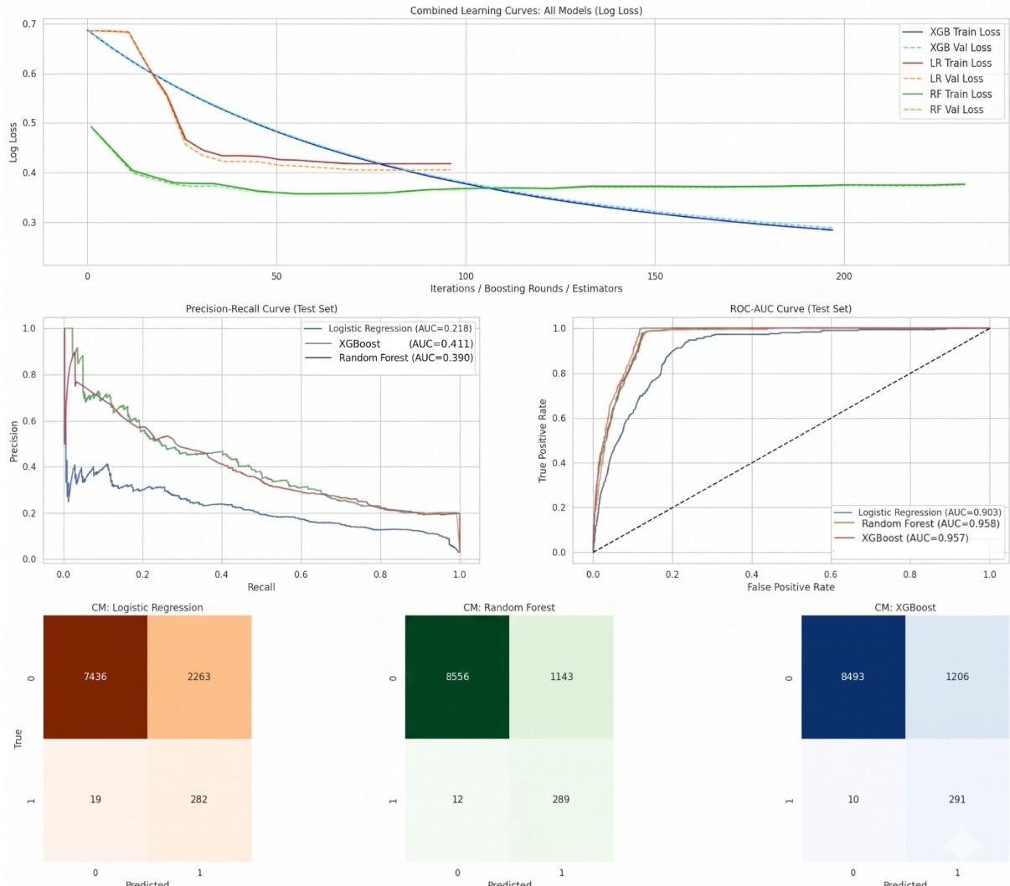
Results - One Shot Training
Train (45k) and val (20k) from labeled, while Test (10k) from unlabeled set
Accuracy based models

Slide 8
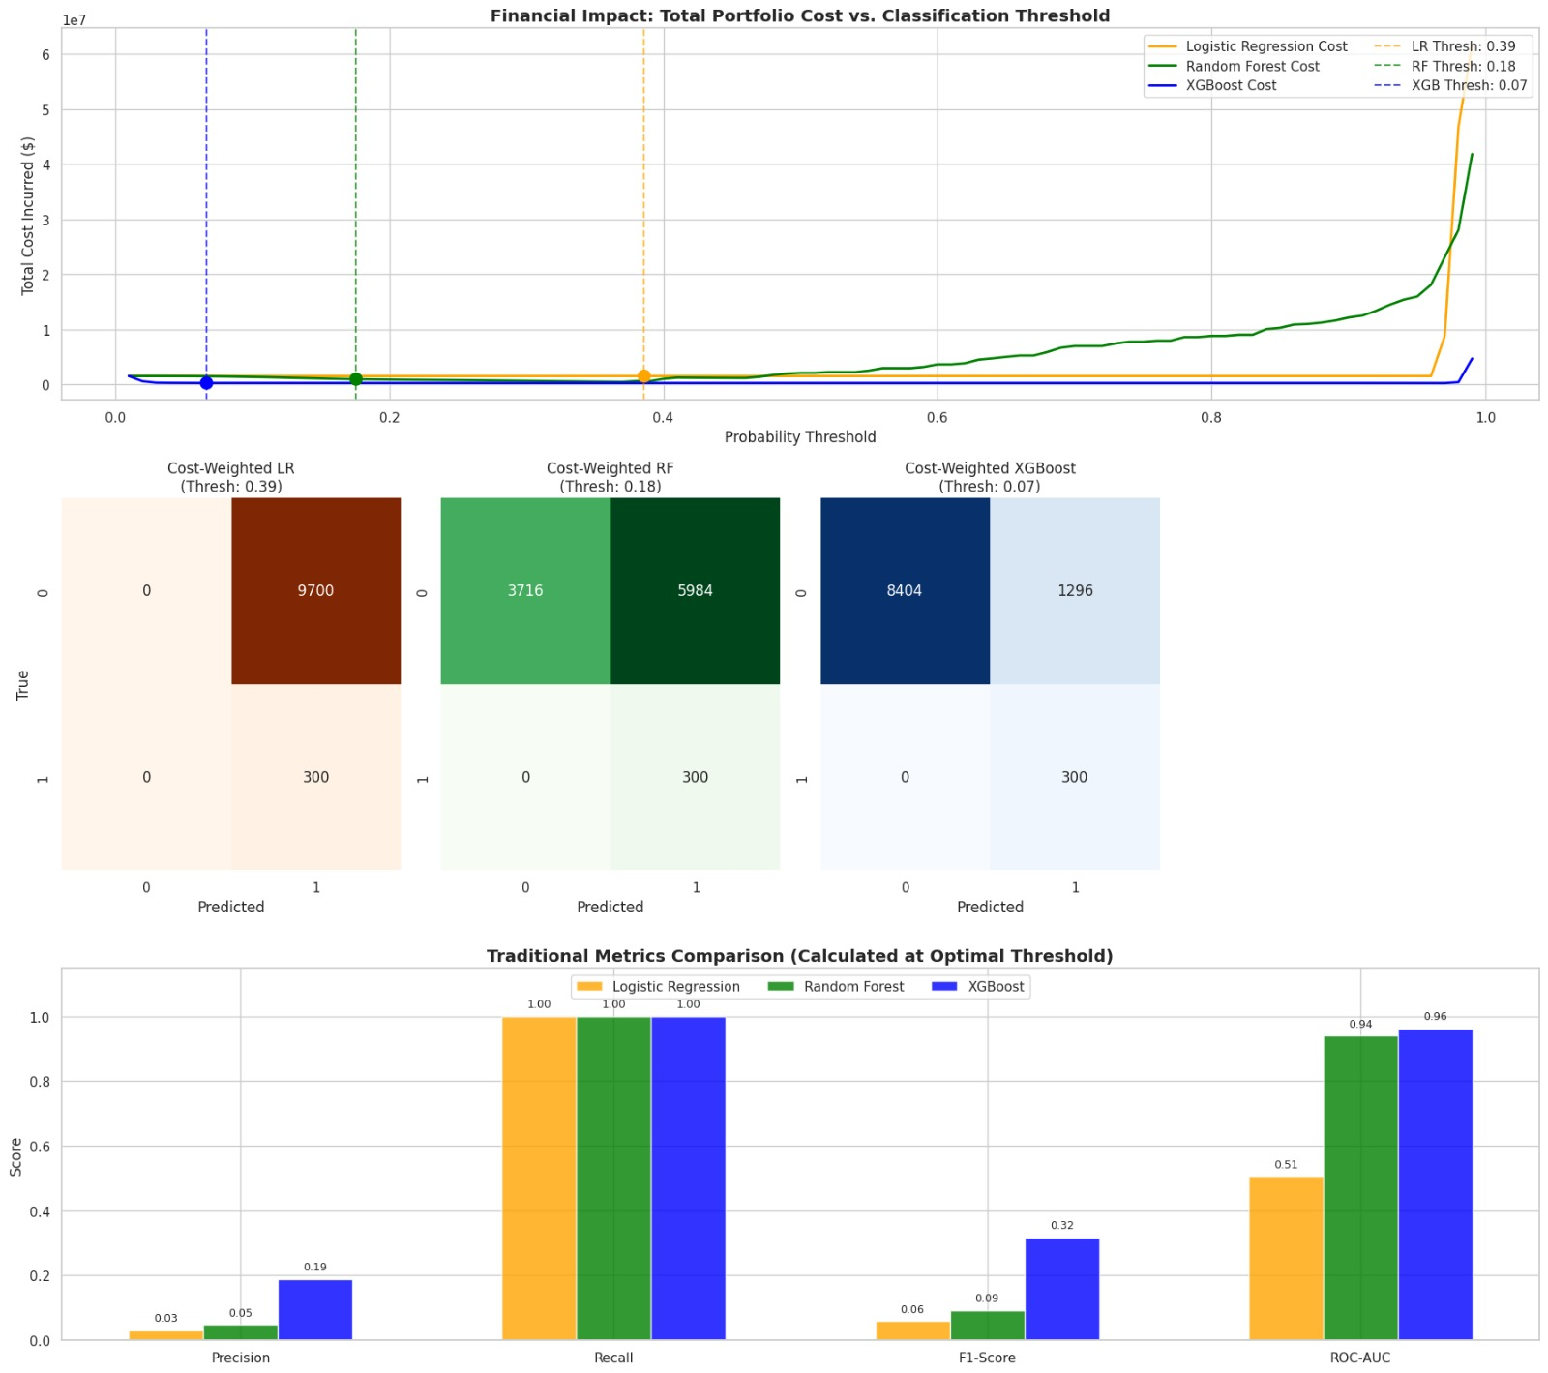
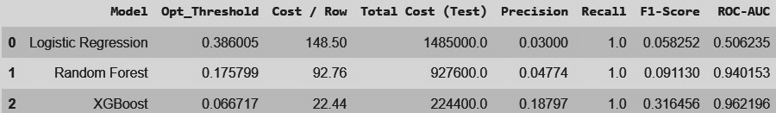
Results - One Shot Training
Train (45k) and val (20k) from labeled, while Test (10k) from unlabeled set
Financial cost based models

Slide 9
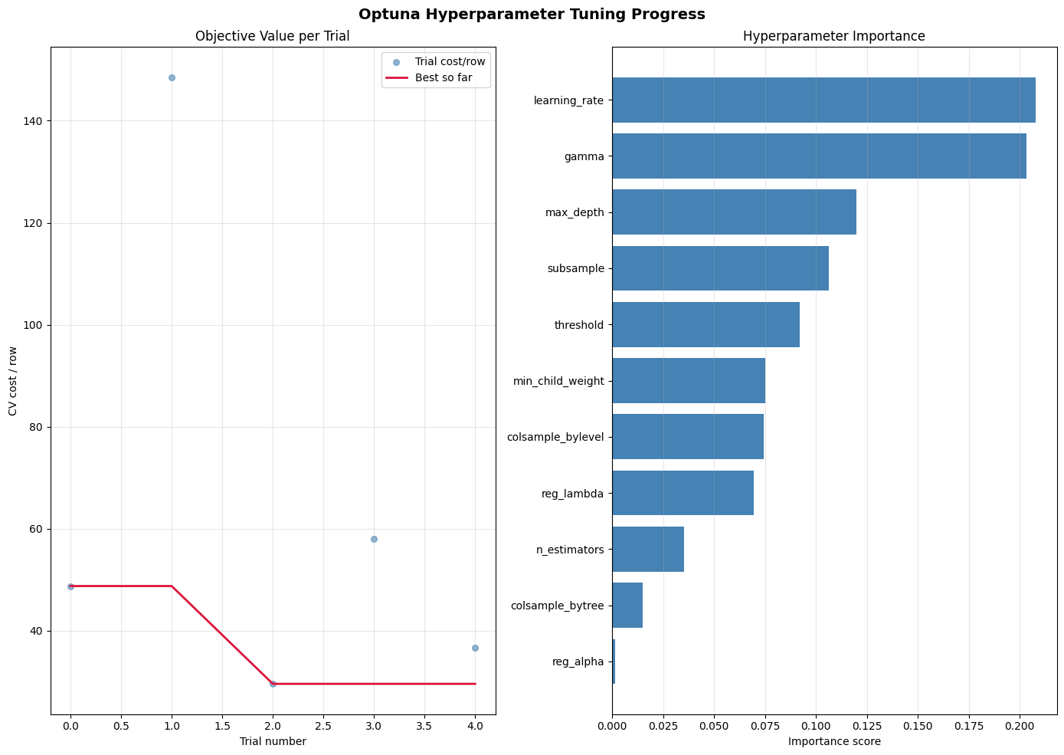
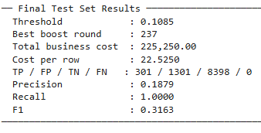
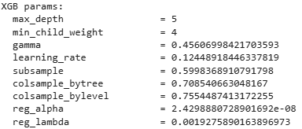
Grid Search (baseline) model
Case 1: Train (45k), val (10k) and test (10k) from labeled set only

Slide 10
Various Active Learning strategies
Cost-Weighted: Selects highly uncertain predictions and scales them by their financial impact (insured amount) to prioritize reviewing costly borderline cases.
Uncertainty: Selects the most ambiguous samples closest to the 50% decision boundary, where the model is least confident.
Diversity (Cluster + Uncertainty): Selects a broad range of hard-to-predict samples by combining the model's uncertainty with spatial distances from K-means clusters to avoid querying redundant data points.
Expected Cost Reduction: Selects samples with the highest potential financial regret by weighing the specific monetary penalties of making a false positive versus a false negative.

Slide 11
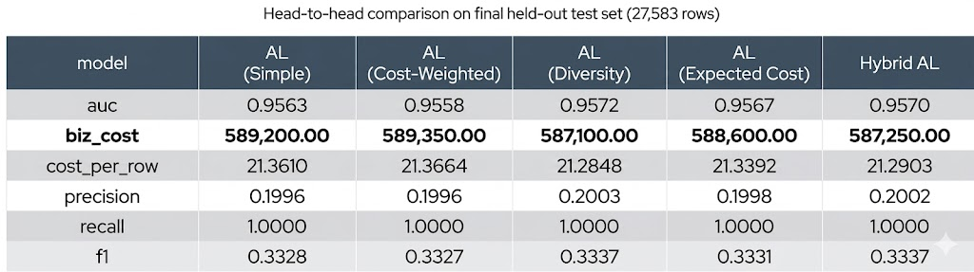

AL (various strategies) vs Hybrid AL comparison on Out-of-Sample (OOS) test
train_size | 46,000 | 46,000 | 46,000 | 45,675
Δ Hybrid AL vs AL (Cost-Weighted)
AUC : +0.0012
Business cost: -2,100.00 ✅ cheaper
Recall : +0.0000
F1 : +0.0010
Δ Hybrid AL vs AL (Simple)
AUC : +0.0007
Business cost: -1,950.00 ✅ cheaper
Recall : +0.0000
F1 : +0.0009
Δ Hybrid AL vs AL (Diversity)
AUC : -0.0002
Business cost: +150.00 ❌ more expensive
Recall : +0.0000
F1 : +0.0000

Slide 12
AL (various strategies) vs Hybrid AL comparison on Out-of-Sample (OOS) test
(remove expected cost strategy (it show performance instead of improvement))
train_size | 46,000 | 46,000 | 46,000 | 46,000 | 45,675
Δ Hybrid AL vs AL (Expected Cost)
AUC : +0.0003
Business cost: -1,350.00 ✅ cheaper
Recall : +0.0000
F1 : +0.0006
Δ Hybrid AL vs AL (Simple)
AUC : +0.0007
Business cost: -1,950.00 ✅ cheaper
Recall : +0.0000
F1 : +0.0009
Δ Hybrid AL vs AL (Cost-Weighted)
AUC : +0.0012
Business cost: -2,100.00 ✅ cheaper
Recall : +0.0000
F1 : +0.0010
Δ Hybrid AL vs AL (Diversity)
AUC : -0.0002
Business cost: +150.00 ❌ more expensive
Recall : +0.0000
F1 : +0.0000

Slide 13
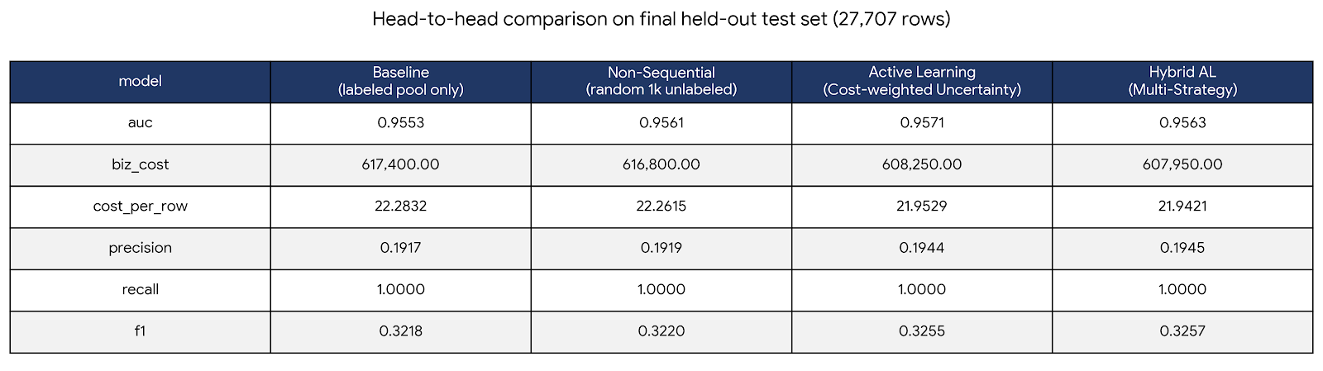
Baseline vs AL vs NSL vs Hybrid AL comparison on Out-of-Sample (OOS) test
Δ Hybrid AL vs AL (Expected Cost)
AUC : +0.0003
Business cost : -1,350.00 ✅ cheaper
Recall : +0.0000
F1 : +0.0006
df_unlabeled total rows : 30,000
seen rows (union, deduped) : 2,293
final held-out test rows : 27,707

Slide 14
References
A] UK Data Sources Used
Population, Occupation, Housing:
ONS Labour Force Survey
UK Housing Survey 2023
Gov.uk English Housing Data
Risk Maps:
Environment Agency Flood Risk Map
Met Office Severe Weather Patterns
Insurance Market:
Association of British Insurers (ABI) Home Insurance Report
Insurance Fraud Bureau (IFB) Fraud Typology
FCA Household Insurance Market Analytics
Payment Behaviour:
Experian UK Financial Wellness Index
FCA Consumer Risk Survey
C] Regulatory & Government Sources
Financial Conduct Authority (FCA) (2024). Home Insurance Pricing Practices.
Auto-renewal regulations, price walking reforms
Environment Agency (2024). Flood Risk Assessment.
10% of English homes in flood zones
B] Academic & Industry Sources
Mordor Intelligence (2024). UK Home Insurance Market Report. https://www.mordorintelligence.com/industry-reports/uk-home-insurance-market
Property type distribution, premium ranges
Mintel (2024). UK Home Insurance Market Report 2024. https://store.mintel.com/report/uk-home-insurance-market-report-2024
Market size (£9.4B forecast), ownership rates
GlobalData (2024). UK Household Insurance Market Dynamics.
GWP growth, premium inflation, claims landscape
Confused.com (2024). UK Home Insurance Statistics. https://www.confused.com/home-insurance/home-insurance-statistics
Average premiums (£396), claim frequencies
Uswitch (2025). Home Insurance Statistics. https://www.uswitch.com/home-insurance/studies/home-insurance-statistics-uk/
Weather claims (£585M), regional variations
Association of British Insurers (ABI) (2024). Insurance Fraud Statistics.
10-15% fraud rate benchmark
Office for National Statistics (ONS) (2021). UK Census - Housing Stock.
Property age distribution, urban/rural split
English Housing Survey (2023). Housing Stock Report.
Property condition, age bands
Economic and social cost of fraud 2023 to 2024
Uncovering the real cost of fraud
Insurance Fraud Taskforce: interim report

Slide 15
THANK YOU

Slide 16
Next Steps
Analyze performance of neural networks in comparison to AL.
Weighted average of Financial cost and accuracy for a new loss function taking into account both the aspects.

Slide 17
Cost-Weighted: Selects highly uncertain predictions and scales them by their financial impact (insured amount) to prioritize reviewing costly borderline cases.
Uncertainty: Selects the most ambiguous samples closest to the 50% decision boundary, where the model is least confident.
Diversity (Cluster + Uncertainty): Selects a broad range of hard-to-predict samples by combining the model's uncertainty with spatial distances from K-means clusters to avoid querying redundant data points.
Expected Cost Reduction: Selects samples with the highest potential financial regret by weighing the specific monetary penalties of making a false positive versus a false negative.

